Slide 1
Polarities
Spiritual Life in the modern era
As Revealed to John in ἀποκάλυψις 3

Slide 2
The Last Book in the Bible: a Re-Introduction
ἀποκάλυψις means “Revelation”
Modern derivatives:
Apocalypse
A “Tragedy of Biblical (epic) proportions”
Dystopia (not Utopia)
But it’s a “revelation of Jesus Christ” (Rev.1:1)
I.e., GOOD news! (Depending on your perspective)
Bad news for “The 1%”
“In the World System, you will have BIG trouble.
But be of good cheer, for I have overcome the World System.”
John 16:33
Notes:
Re-Intro: b/c Attention Span Problems→ 1 Month Ago
“Rev” ~”Rev-s” → Jeopardy! → **HUGE Impact 2Dy…
**All WRONG/Misunderst! → **GOSPEL
= **Jn.16 JC Solut. → “Trouble”=Intuitiv,TRUE→cf. **”Wall St

Slide 3
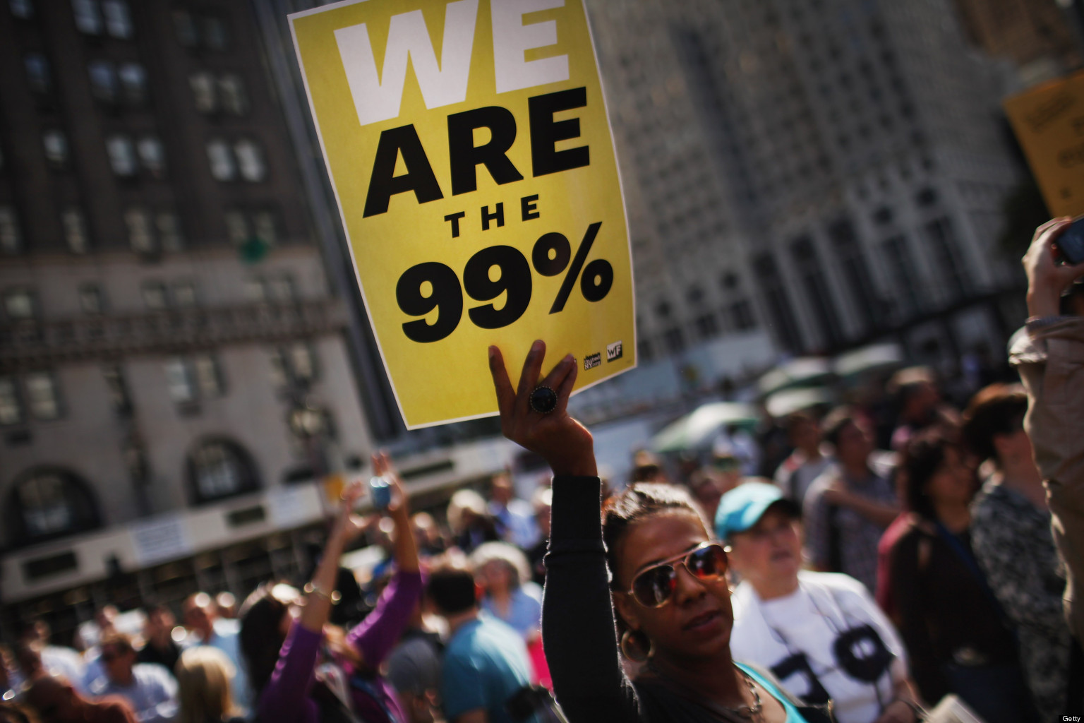
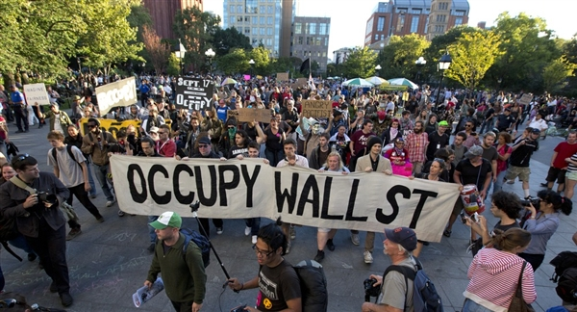
The Last Book in the Bible: a Re-Introduction
But where are you now?
“In the World System, you will have BIG trouble.
But be of good cheer, for I have overcome the World System.”
John 16:33
Notes:
“Occupy” = Agree w/ JC \ ** Prob=1% v. 99%=TRUE
** BUT: ~Solution → JC/Bible=Solut. → 4k Yrs Old

Slide 4
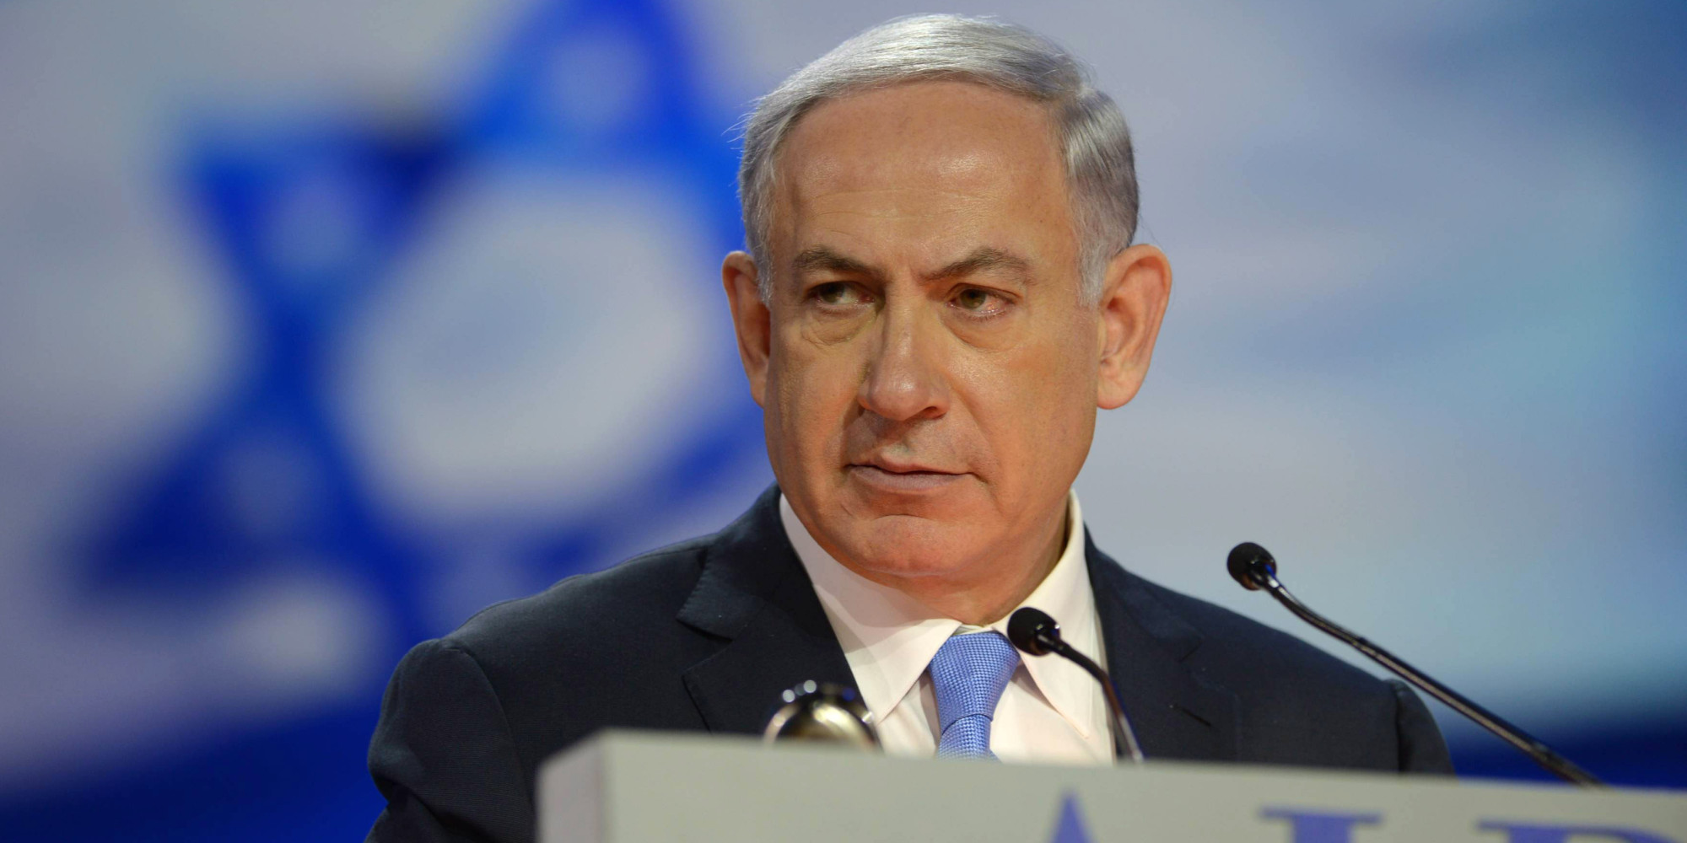
The Course of Human History
“Great Trouble”
Israel v. Muslims
Cashless Society/WMD
Russia/China/Europe
Globalization
Israel
‘Church Age’
‘Jacob’s Trouble’
“Peace on Earth,
Good Will Towards Men”
Notes:
Hist=**Course=Purpose 2 Life: U & Me
G’s Solution 2 “1%” = WOG = KOG = **“Peace”=2k Yrs Ago
**Israel=2k yrs **Chrch=2k Yrs **J.TRBLE=ISRAEL=7 yrs
** “GRT”=Headlines ** Israel=**Ben.N=O.T. Belv→FrontLine
Muslims ~WIN → ** Russia,China=200M,EU=“Unity!”
** Global=Esp. 2DAY=Critic!!! ‘08 **Technology = AMAZ.DETAIL
ALL=MY LIFETIME: Esp. Global=Imposs w/Commies→Space Station

Slide 5

The Polarization in “Church History”
Radical Reformation
17th C
Cool
Un-Cool
2nd→4/5th C
6th → 16th C
“A Great Disturbance…”
VERY Sickly
19th C
Notes:
Un-Cool→Sardis=CURRUPT ** Radic=EXCITING! Thrives!
=2Dy, 2! “??Where??” → 3rd World: India/China/Africa
Lollards, Huguenots, Anabaptists, Wesleyans, Costals, Baptists(!?)
**Sickly=Rise “Libs” → Prominent → “1st Wrld”=USA=Implodes
**Co-Exist (Overlaps) → Radic ^ Sick=POLAR→**O.B.Wan=OK!

Slide 6
Philadelphia: “Brotherly Love”
“The Gateway of the East”
“Open Doors” → Growth / Action
JC is IN CHARGE
Revelation 3:7-8 (NIV) "To the angel of the church in Philadelphia write: These are the words of him who is holy and true, who holds the key of David. What he opens no one can shut, and what he shuts no one can open. I know your deeds. See, I have placed before you an open door that no one can shut…
Colossians 4:3 pray for us, that God will open up to us a door for the word…
Notes:
“Phil”=“LOVE”=Picture: Chosen **v7= “Chrch of Open Door”
** Phil=“Gatewy” =**EXCITING! Grwth! =3rd World 2DY
**=Opportun→AP: Pray 4 b/c **JC=In Charge! “~1 Shut!”
?? Opportun?? Xianity=Decline! “My HC=Decline!” → ~Pray ^…

Slide 7
Philadelphia: “Brotherly Love”
“The Gateway of the East”
“Open Doors” → Growth / Action
JC is IN CHARGE
Requires WORKERS
Revelation 3:7-8 (NIV) "To the angel of the church in Philadelphia write: These are the words of him who is holy and true, who holds the key of David. What he opens no one can shut, and what he shuts no one can open. I know your deeds. See, I have placed before you an open door that no one can shut…
Matthew 9:37-38 "The harvest is plentiful, but the workers are few. Therefore ask the Lord of the harvest to send out workers into His harvest."
Notes:
w/o Workers → Diff. Prayer: “Pls. Raise Workers…”
=R. Prob → DMT Retreat → FST=Will Discuss More

Slide 8
Philadelphia: “Brotherly Love”
“The Gateway of the East”
“Open Doors” → Growth / Action
JC is IN CHARGE
Requires WORKERS
Revelation 3:7-8 (NIV) "To the angel of the church in Philadelphia write: These are the words of him who is holy and true, who holds the key of David. What he opens no one can shut, and what he shuts no one can open. I know your deeds. See, I have placed before you an open door that no one can shut…
Notes:
w/o Workers → Diff. Prayer: “Pls. Raise Workers…”
=R. Prob → DMT Retreat → FST=Will Discuss More
YET: We Hv LOTS of Gud Workers = Ignoring Open D??
OR: Bashing Heads @Closed D? → JC=KeyMaster
AP: ~Force Open D → ASK JC…

Slide 9
Philadelphia: “Brotherly Love”
“The Gateway of the East”
“Open Doors” → Growth / Action
JC is IN CHARGE
Requires WORKERS
Means Asking for CHANGE
Revelation 3:7-8 (NIV) "To the angel of the church in Philadelphia write: These are the words of him who is holy and true, who holds the key of David. What he opens no one can shut, and what he shuts no one can open. I know your deeds. See, I have placed before you an open door that no one can shut…
Notes:
Chng=Opportun / MESSES!! / Victories, Joy!!
??Ppl b Shut-Ins?? →PS/4!! → Sad: My Dad!
=MOST Xians 2DY

Slide 10
Philadelphia: “Brotherly Love”
“The Gateway of the East”
“Open Doors” → Growth / Action
JC is IN CHARGE
Requires WORKERS
Means Asking for CHANGE
Means Oppression
Revelation 3:9 'Behold, I will cause those of the synagogue of Satan, who say that they are Jews and are not, but lie—I will make them come and bow down at your feet, and make them know that I have loved you.
Notes:
“Synagogue” = Crucified JC = RELIG. Oppress
Even Xians → Acts 20 “Savage Wolves”
AP: ~B Distracted… → Open D.=Matter

Slide 11
Philadelphia: “Brotherly Love”
“The Gateway of the East”
“Open Doors” → Growth / Action
JC is IN CHARGE
Requires WORKERS
Means Asking for CHANGE
Means Oppression
Revelation 3:9 'Behold, I will cause those of the synagogue of Satan, who say that they are Jews and are not, but lie—I will make them come and bow down at your feet, and make them know that I have loved you.

Slide 12
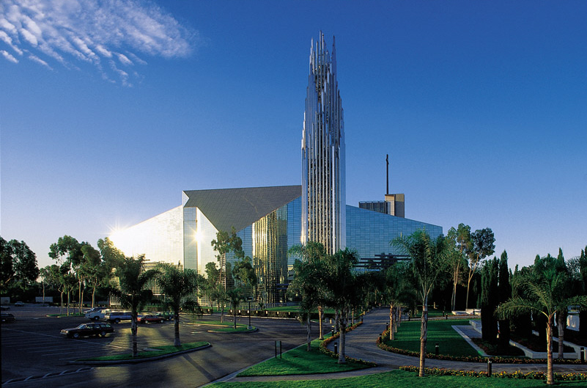
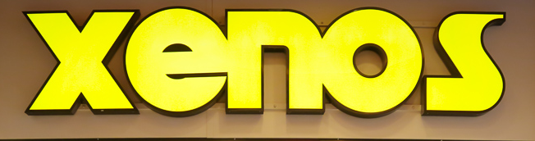
Philadelphia: “Brotherly Love”
“The Gateway of the East”
“Open Doors” → Growth / Action
JC is IN CHARGE
Requires WORKERS
Means Asking for CHANGE
Means Oppression
Means Knowing What Matters
Revelation 3:8 … because you have a little power, and have kept My word, and have not denied My name.
Mega-Show
Notes:
?Matters → ~Programs/Buildings/$$$
WOG=Matters → Ignored Modern Ch → **“Mega-Show”
IL:Crystal Cath ~ “Little Pwr” → ~Blv WOG! (rejected son)
=ALLURING! IL: Xenos Sign

Slide 13


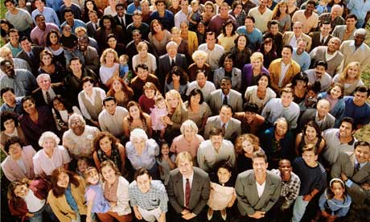
Laodicea: the Cosmo-Church
“Lukeworm”= “PC”
Revelation 3:14-16 "To the angel of the church in Laodicea write: The Amen, the faithful and true Witness, the Beginning of the creation of God, says this: 'I know your deeds, that you are neither cold nor hot; I wish that you were cold or hot. 'So because you are lukewarm, and neither hot nor cold, I will spit you out of My mouth.
I’m Right
I’m Right
I’m Right
I’m Right
“PC” Means “Personally Confused”
Notes:
“Lukew” = Afraid Cultur = Appease/~Stir Probs
= **“PC” Culture → **Trump → PPL KNOW!!
**Oscars Hypocrisy

Slide 14
Laodicea: the Cosmo-Church
“Lukewarm”= “PC”
Rich/Powerful
Revelation 3:17 'Because you say, "I am rich, and have become wealthy, and have need of nothing," and you do not know that you are wretched and miserable and poor and blind and naked,
Notes:
$$=Deceptive: SELF-DEPEND/Power

Slide 15
Laodicea: the Cosmo-Church
“Lukewarm”= “PC”
Rich/Powerful
Not Following JC’s Leadership
Revelation 3:18 I advise you to buy from Me gold refined by fire so that you may become rich, and white garments so that you may clothe yourself, and that the shame of your nakedness will not be revealed; and eye salve to anoint your eyes so that you may see.
Notes:
Ironic: Gold/Garmets/Eye Salve=EXPORTS
Sophisticated City
USA=Alluring/Sophisticated/Full of Crap

Slide 16
Laodicea: the Cosmo-Church
“Lukewarm”= “PC”
Rich/Powerful
Not Following JC’s Leadership
Not Zealous
Revelation 3:19 'Those whom I love, I reprove and discipline; therefore be zealous and repent.
Notes:
=Complacent / Comfortable / Cozy Xians
=TRIBAL → PRISONS → SHUT-INS

Slide 17
Laodicea: the Cosmo-Church
“Lukewarm”= “PC”
Rich/Powerful
Not Following JC’s Leadership
Not Zealous
Not Too Late…
Revelation 3:20 'Behold, I stand at the door and knock; if anyone hears My voice and opens the door, I will come in to him and will dine with him, and he with Me.
Notes:
GOSP: =Personal Relationship \ ~Go2 Chrch, ~Raised, ~Ritual
Seminary Fools: ~See “Any1 hears…”

Slide 18
Fortified Fellowship
What matters
God’s Open Doors
Step Down Off the Throne!
Guard your treasure!
Living for the long haul
Don’t flip out! (Get shaken)
Revelation 3:10 'Because you have kept the word of My perseverance, I also will keep you from the hour of testing, that hour which is about to come upon the whole world, to test those who dwell on the earth.
Revelation 3:8 because you have a little power…
Revelation 3:8 because you have a little power, and have kept My word
Revelation 3:8 because you have a little power, and have kept My word have not denied My name.
Notes:
Pressures=Nd “Fortified” →Philadelph=**Mattrs:
** Doors=G’s Opport: ~My Career/Greed/Whims 1Jn.2:15
**Throne=v.8=B WEAK! ~Fortifying “My Posit” →JC “I ~Roll…”
**Treasure=v8=WOG=VAST! Imagine Life w/o!! =Best Defens/Offens
**Long Haul=v.8=ETERNAL Life=Faithful
**~Flip Out=WORD 2x=Hard @End Times=RAPTURE→ 2 Mny Lies!!
AP: U Young People → ~FORGET =Older Xian Disease→Keep WOG!!

Slide 20
Philadelphia: “Brotherly Love”+--
What matters
Follow God’s Opportunities
(Not my greed, whims, trickery…)
Be Weak! I.e., Step Down Off Your Throne!
Guard your treasure!
Living for the long haul
Don’t flip out! (Get shaken)
JC Opens & Closes Doors, Not You & I!
Ain’t nothin’ nobody can do about it!
Real Strength Comes from JC, not “From Inside Me”!
“For when I am weak, then I am strong…”
“Just give me a little trust!” He says. “How much?” “See this little teeny seed…?’
Guarding, Spreading God’s Word
Say it! Teach it! Enjoy it!
“Freely you have received, now freely give…”
Opposed / Oppressed / Attacked / Mistreated / Criticized
“If the World System hates you, that’s because it hated me first.”
Ain’t nothing: “If God is for you, who can be against you?”
Where Opposition Exists, God’s Power is Unleashed
Kept “Out of” the Great Tribulation Period
Jn. 14; 1Thes.4; 1Cor.15 Harpadzo
“For those who dwell upon the earth” meaning “those invested here” 1Thes.5:9
Stay the course! Don’t drift away! Don’t flip out!!
“The Great Falling Away” occurs, which is Spiritual Captivity
The Spiritual Oscars Night is Around the Corner
God sees, God knows, God will never forget what you did for Him.
Everything will make crystal-clear sense:
There is a definite flow to human history, and our future!!
A great moment of clarity: “the first shall be last, vice-versa”
The purpose of “rewards” – so God can clarify who’s who & what’s what.
“The Gateway of the East” - Growth / Action / “Open Doors”
A “Little Strength”
Imagine life without God’s Word!
Superstition, Fear
Confused Love
Humans With Low Value
Cannot live by bread alone…”
Your best defense,
Your best weapon (Eph.6)
Notes:
Throne: we spend our lives trying to build it up, protect, defend, increase our “position of strength”. JC says, “That’s not how I roll…on the back of your strength…!”
Nice: he provides for what He asks! Doesn’t want you getting disoriented by the weakness you may feel, or that others use to describe you!
As a parent, I’m not like this … I tell those boys, “Son, get ON it!” I don’t care if they feel like a loser. I tell them, “Don’t be a looser,” so they pretend. Even worse, they stop talking to you, even thought you may have what they need – because they don’t want to disappoint your expectations.
“Be weak” does not mean “go ahead & screw up,” or “Be lazy!” Or “It’s my fate…” NO! “For when I am weak, then I’m strong!’

Slide 21
Or, Sink Into Laodicea (=TONS of Drifting Xians)
Money, money, money
Waffling, appeasing, politicking.
Pretentious, pride, tough-guys & gals.
Lights, big projects, money-grubbing, noise & hot air
Nicey-nice sales pitches
Touchy, hyper-sensitive, church-hopping

Slide 22
Or, Sink Into Laodicea (=TONS of Xians)
Lots of…
Looks like…
Money, money, money
Waffling, appeasing, politicking.
Pretentious, pride, tough-guys & gals.
Lights, big projects, money-grubbing, noise & hot air
Nicey-nice sales pitches
Touchy, hyper-sensitive, church-hopping
Every year I come to the Elder’s Retreat with “Delusions of Grandeur” – “We need a big, fat “NeoXenos” sign flashing establishing our presence! They say, “Ok,” then give me THIS SIGN (from NYE/Phili)

Slide 23
What’s the Big Diff?
Brotherly Love
Laodicea
Things are messy, sloppy
Spick & Span

Slide 24
The Span of “Church History”
Coolness
4th/5th C
700s-1400s
1500s-1700s
Polar Opposites
2nd C
Un-Coolness
Head Trip
Love-Confused
Persecution
Power Trip
1700s-Today
Healthy
1900s-Today
Cancerous

Slide 25
The Span of “Church History”
Coolness
4th/5th C
700s-1400s
1500s-1700s
Polar Opposites
2nd C
Un-Coolness
1700s-Today
1900s-Today
Healthy
Cancerous
Head Trip
Love-Confused
Persecution
Power Trip

